Slide 1

Prediction of Alzheimer's Disease Progression with Multi-Information
Generative Adversarial Network
周越
2020/10/29
Notes:
更多模板请关注：https://haosc.taobao.com

Slide 2
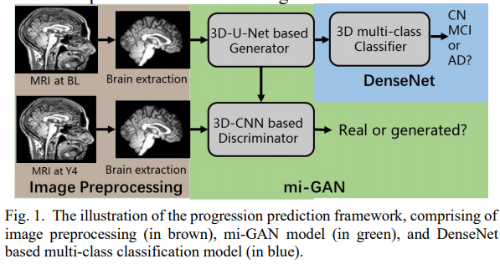
progression prediction framework
First, image preprocessing is performed for the ADNI data.
Then, a 3D patch-based mi-GAN model is constructed to generate estimated brain MRI image at a future time-point (i.e., Year 4, Y4), conditioning on the brain MRI image at baseline time-point (i.e., BL).
Finally, a 3D DenseNet based multi-class classification model is established to identify the clinical stage of the estimated brain MRI.

Slide 3
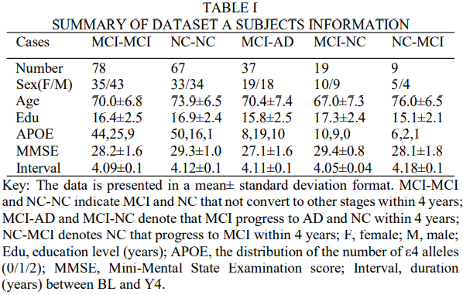
dataset

Slide 4
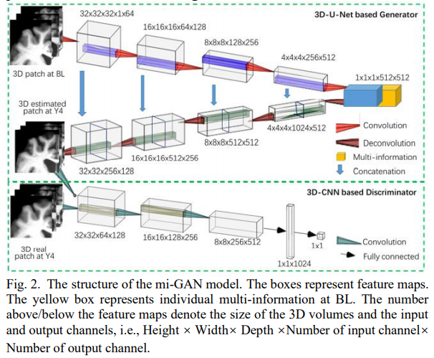
mi-GAN model

Slide 5

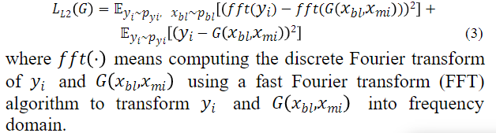
loss function
α > 0, β > 0 and γ > 0 are three tunable hyper-parameters
gradient difference loss(GDL loss):

Slide 6
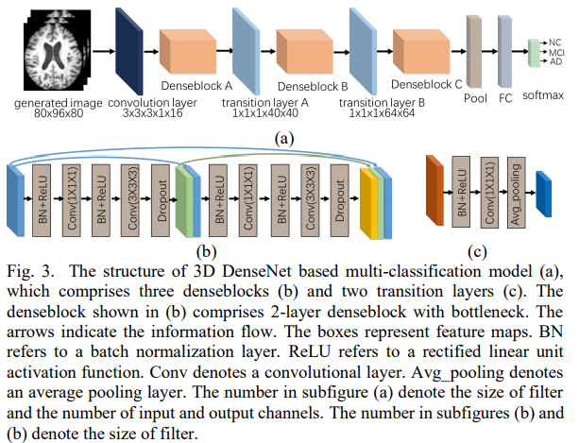
3D multi-classification model

Slide 7
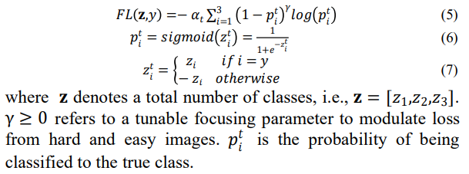
focal loss (FL)

Slide 8
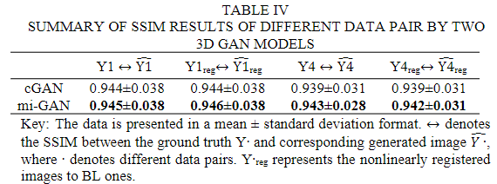
experiments——structural similarity index (SSIM)

Slide 9
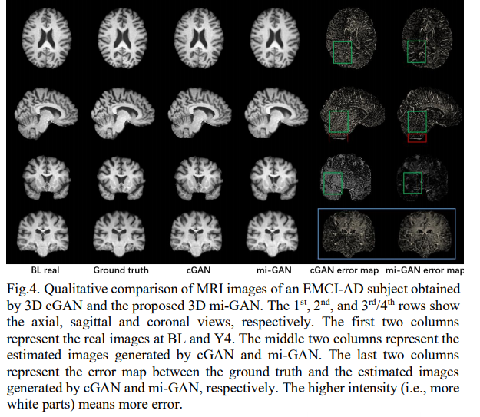
experiments

Slide 10
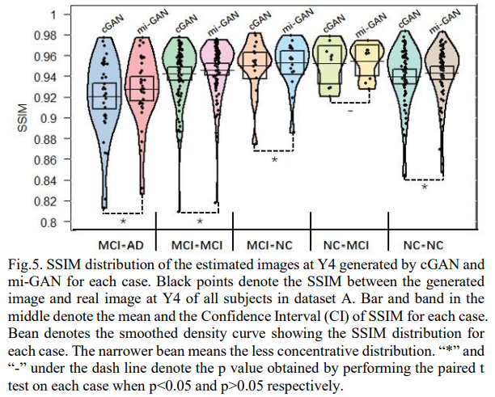
SSIM distribution

Slide 11
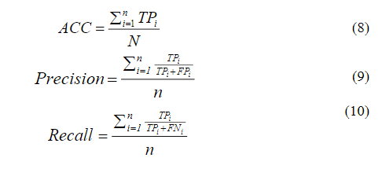
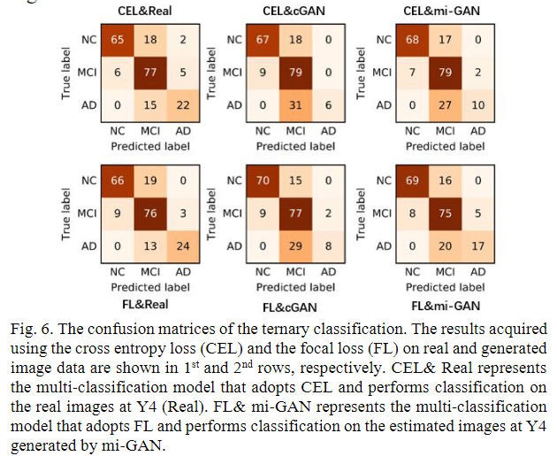

performance of multi-classification model

Slide 12
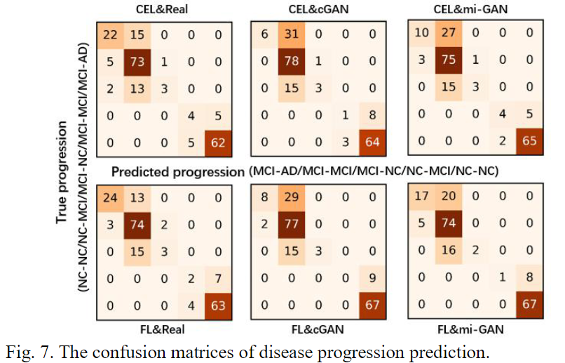
performance of multi-classification model
MCI-AD, MCI-MCI, MCI- NC, NC-MCI and NC-NC.

